Slide 1
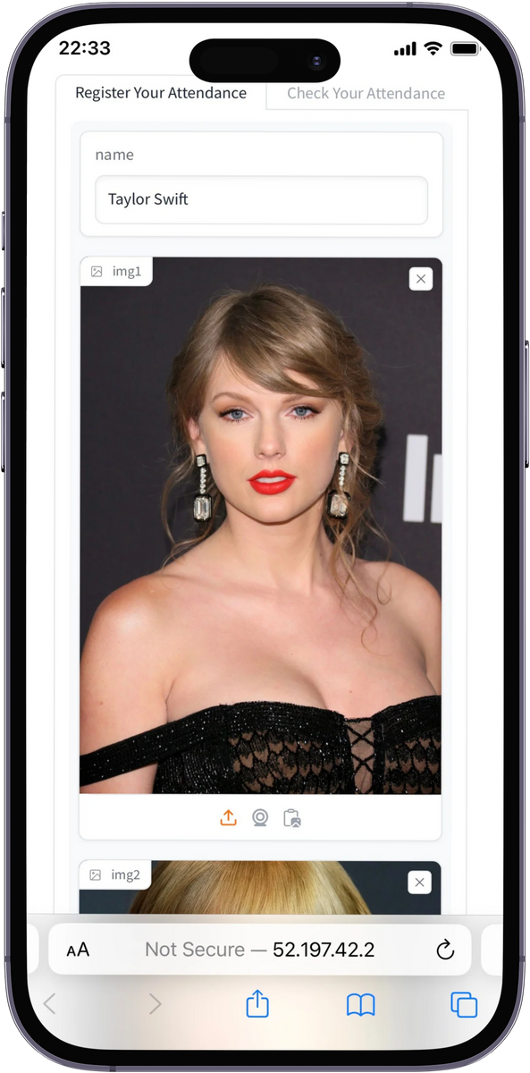
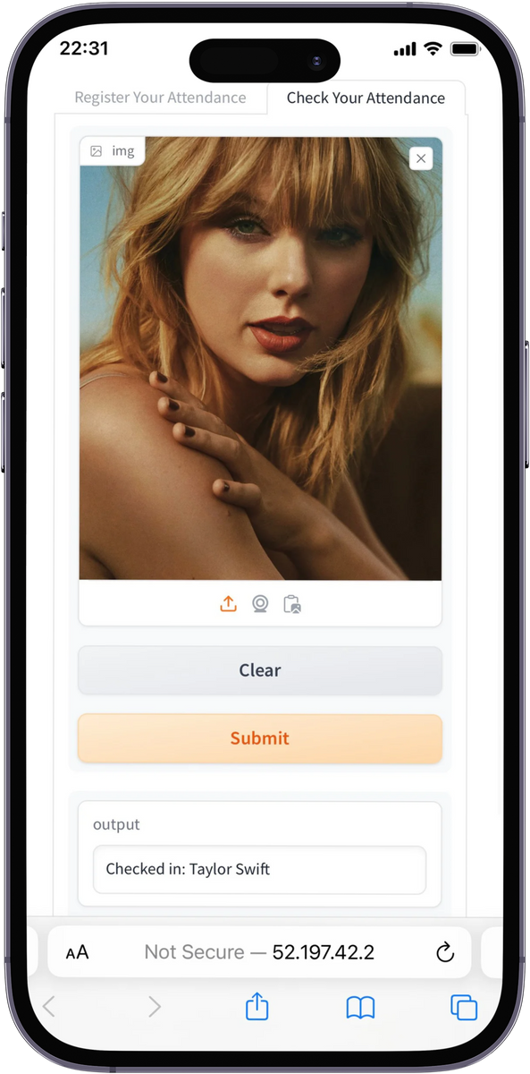
PRESENTED BY FACEAPP GROUP
MULTI-EDGE CAPABLE ATTENDANCE SYSTEM
17 MAY, 2024

Slide 2


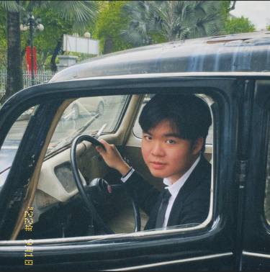




TEAM
MEMBERS
Mr. Eric Le
Khai Vinh Han
Bui Thanh Ngan Pham
Mentor
Team Leader
Member
Phan Le
Trung Hieu Nguyen
Thanh Thao Bui
Member
Member
Member

Slide 3



PROBLEM STATEMENT
Manual attendance: time-consuming + labor-intensive.
Manual attendance processes can lead to inaccuracies.
Meanwhile: attendance is crucial for maintaining academic standards.
This can lead to loss of interaction, attention, and time.

Slide 4
OUR SOLUTION
FaceApp: AI Attendance
AI-powered attendance system using face recognition.
Benefits:
Time save.
Security Improvement.
High Efficiency.
Solution eliminates manual attendance's time-consuming nature, promoting ease of use and self-awareness.

Slide 5
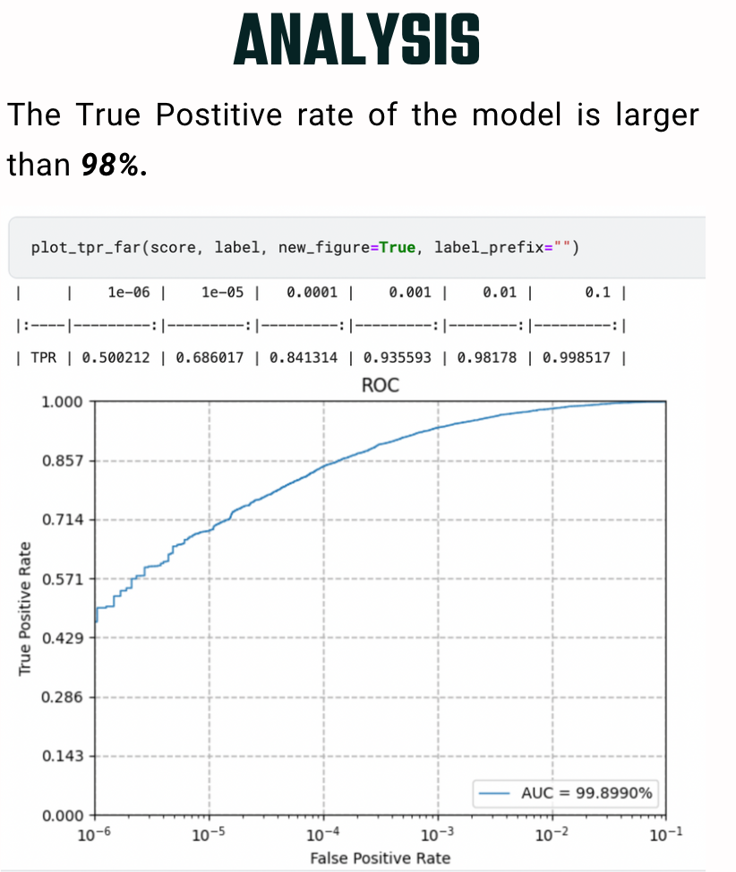
METHODOLOGY
Why choose GhostFaceNet?
Lightweight
High Efficiency
Speed and Accuracy

Slide 6

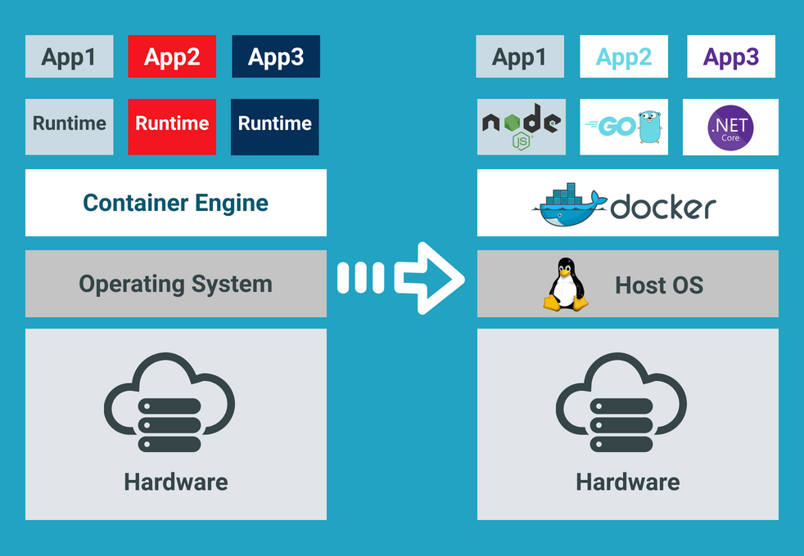
METHODOLOGY
Why Docker?
Highly extensible
Ease of Use
Solves “Works on my PC”

Slide 7

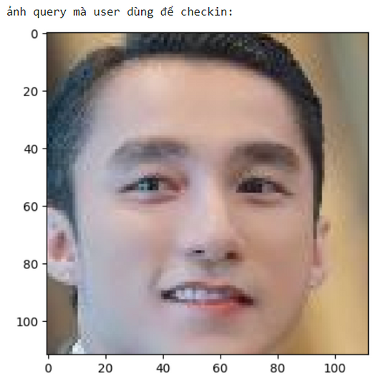
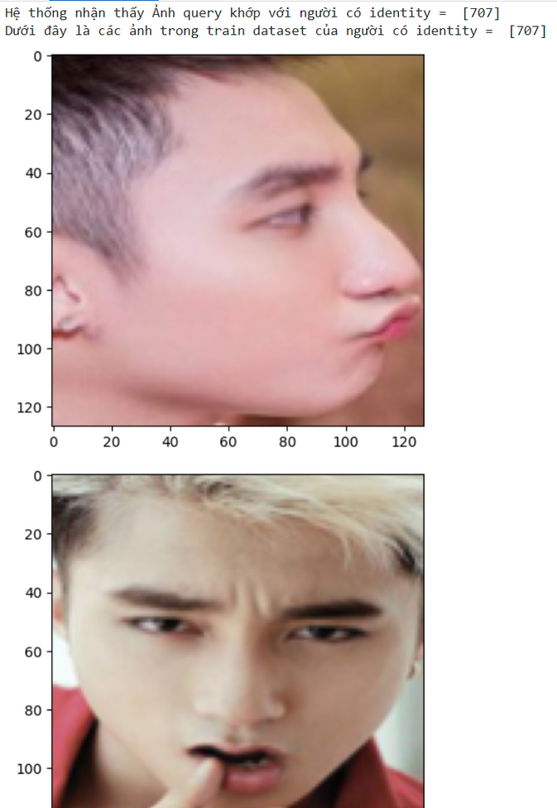
EVALUATION DATASET
The VN-Celeb dataset:
> Number of images: 4720
> Image type: facial images
Extraction method: GhostFaceNets model => 512-dimensional embedding vector
Use Faiss (Facebook AI Similarity Search) for face recognition
Notes:
SLIDE 1:
I'll present the evaluation results and analysis of our face recognition attendance app. The goal of our evaluation was to assess the app's performance in accurately recognizing faces and its overall effectiveness in real-world scenarios.
To assess an application's performance, we need a reliable dataset. In this case, we used the VN-Celeb dataset, specifically designed for Vietnamese celebrity recognition. The dataset contains a total of 4720 facial images.
To process these images, we utilized the GhostFaceNet model to transform each face into a 512-dimensional embedding vector. And in order to achieve efficient face recognition using the extracted embeddings, we use Facebook AI Similarity Search to compare the similarity between the query image and the images in the dataset. Finally, we employed various metrics to thoroughly evaluate the app's performance.

Slide 8
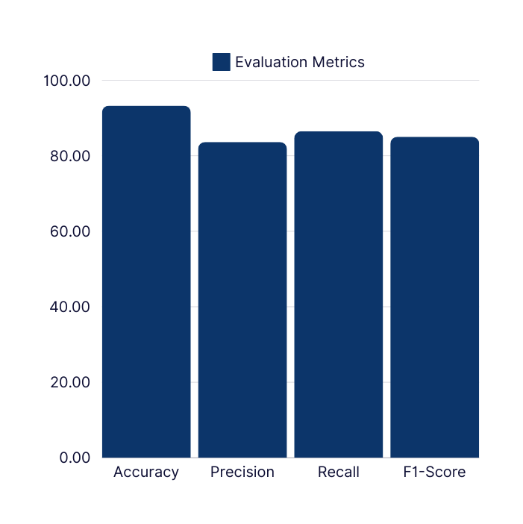
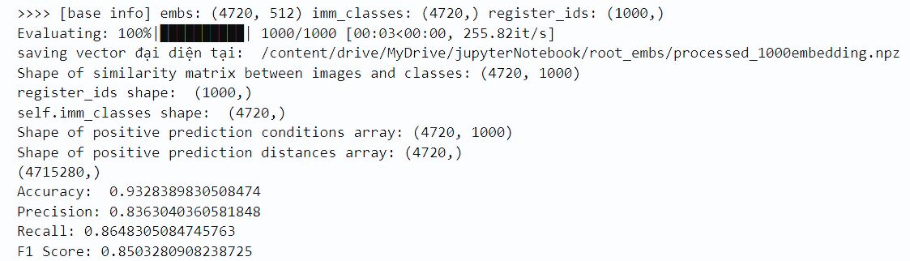
RESULTS &
ANALYSIS
Accuracy: 93.28% - How often the app is right overall
Precision: 83.63% - How often the app recognizes someone correctly
Recall: 86.48% - How often the app finds everyone it should
F1-Score: 85.03% - How good the app is for both finding the correct faces and avoiding mistakes
Notes:
SLIDE 2:
We evaluated the app's performance using several key metrics. The first is accuracy, which sits at an impressive 93.28%. This means out of 100 people trying to use the app, a whopping 93 are recognized correctly. That's a significant level of accuracy you can rely on.
But accuracy alone isn't enough. We also looked at precision, which tells us how often the app correctly identifies someone. Here, the app shines again with a precision of 83.63%. This means when the app recognizes someone, you can be highly confident it's the right person.
Recall is another crucial metric. It measures the app's ability to find everyone it should recognize. Our impressive recall of 86.48% signifies the app effectively identifies a vast majority of the people it needs to.
These individual metrics paint a strong picture, but to get a complete view, we use the F1-Score. This combines precision and recall, and a high score indicates a balanced performance. Our app boasts a high F1-Score, confirming its exceptional ability to identify the right people while minimizing errors.
In simpler terms, these metrics prove our face recognition attendance app is an outstanding performer. This combination of getting identities right consistently, minimizing false positives, and maximizing true positive detection is exactly what you need for a secure and dependable attendance tracking system.
Now that we've covered the core evaluation metrics like accuracy, precision, and recall, let's dive a little deeper into another powerful analysis tool - the Receiver Operating Characteristic curve, or ROC curve for short.

Slide 9
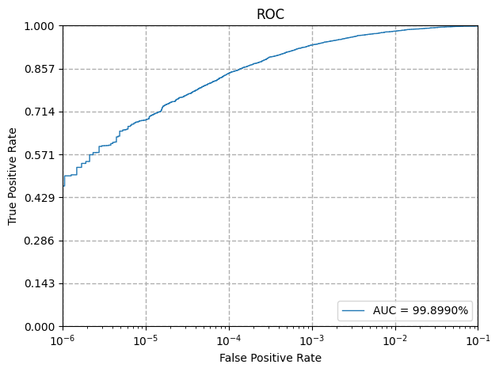
RESULTS & ANALYSIS
Receiver Operating Characteristic (ROC) Curve:
Trade-off between True Positive Rate (TPR) and False Positive Rate (FPR)
Closer to top-left corner = better performance
Area Under the Curve (AUC):
Quantifies overall model effectiveness
Higher AUC = better at distinguishing positive and negative cases
Notes:
SLIDE 3:
The ROC curve shows us a trade-off between two things:
1. Catching everyone who should be recognized (True Positive Rate) – This is like making sure everyone who belongs in the class gets marked present.
2. Avoiding mistakes by not recognizing someone who shouldn't be (False Positive Rate) – This is like accidentally marking someone absent who actually came to class.
An ideal scenario would be catching everyone who should be recognized (high True Positive Rate) while making zero mistakes (low False Positive Rate). The ROC curve helps us visualize how close the app gets to this ideal.
Now, let's talk about the AUC (Area Under the Curve). Imagine the ROC curve as a giant question mark on the graph. The AUC essentially measures the area underneath that curve. A higher AUC value indicates a better-performing model. This AUC score basically tells us that if we randomly selected a positive identity and a negative one, there's a 99.89% chance the app would correctly score and place the positive one higher than the negative one. That's an exceptional level of separation power.
Overall, the evaluation results are promising and showcase the app's strong potential for accurate face recognition in attendance applications. While factors like image quality and pose variations can influence performance, we are continuously exploring methods to address these limitations and further enhance the app's robustness. We believe this face recognition attendance app offers a powerful and reliable solution for managing attendance across various scenarios.

Slide 10
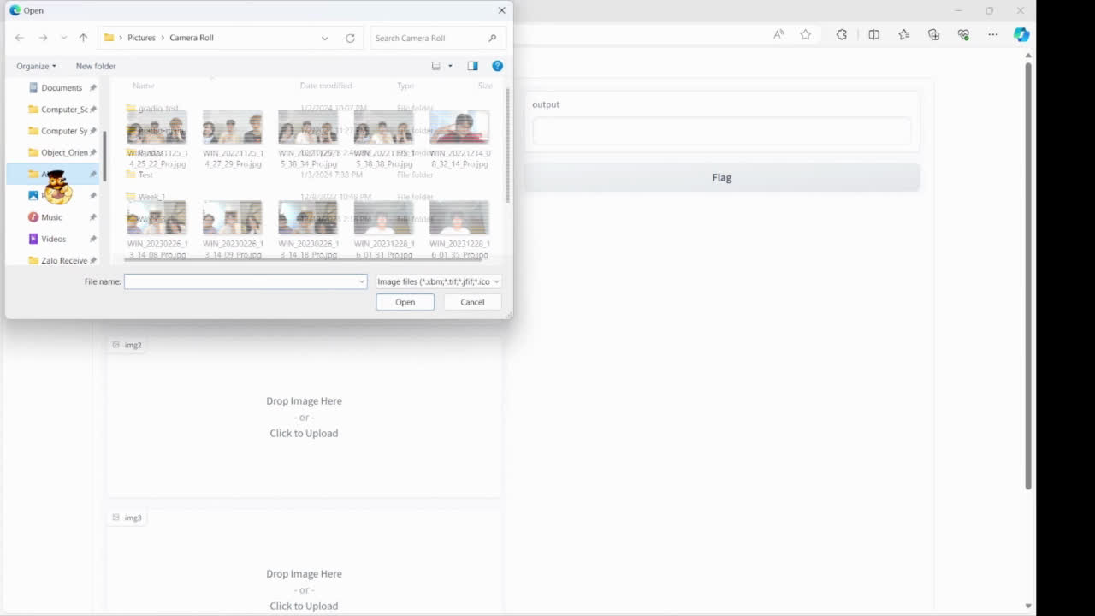
DEMO VIDEO

Slide 11
PRESENTED BY FACEAPP GROUP
THANK YOU
17 MAY, 2024

